Slide 1

Plant Leaf Disease Detection Using Deep Learning
Minor Project
Presented By :-
Vicky Gupta
Ravi Gowri J. Reddy

Slide 2

Introduction
Diseases found in agricultural crops is a major threat that cause production and economic losses as well as reduction in both quality and quantity of agricultural products.
In India 70% of population depend on agriculture and contributes 17% towards the GDP of country Farmers experience great difficulties in switching from one disease control policy to another.
The naked eye observation of experts is the traditional approach, this method be time consuming, expensive and inaccurate.
The crop losses can be minimized by applying pesticides or its equivalent to combat the effect of specific pathogens, if diseases are correctly diagnosed and identified early.

Slide 3
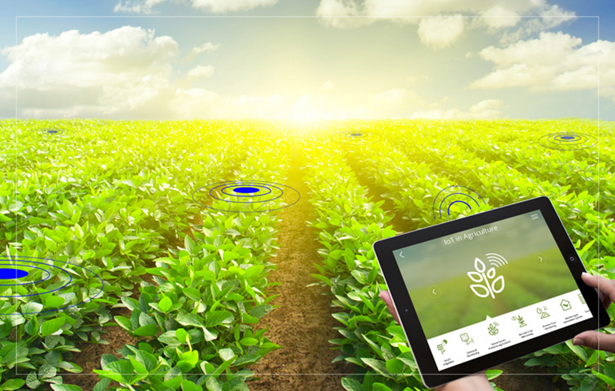


Problem Statement
An expected 70% to 80% Indian economy relies on agriculture business. Indian population, which is increasingly dependent on the agricultural yield. The end goal is kept in mind to develop progressively the diseases need to be examined in earlier. Diseases are investigated utilizing different image processing techniques and diagnosed so that Farmers can overcome from yield and financial loss.
.
.
Figure 1. Leaf Rakshak.

Slide 4

Literature Review
S.No | Title | Author | Model | Data Set | Year
1 | Using Deep Learning for Image-Based Plant Disease Detection | DavidP.Hughes et al. | AlexNet, GoogleNet | Plant Village Dataset | 2016
Table 1. Literature Review

Slide 5
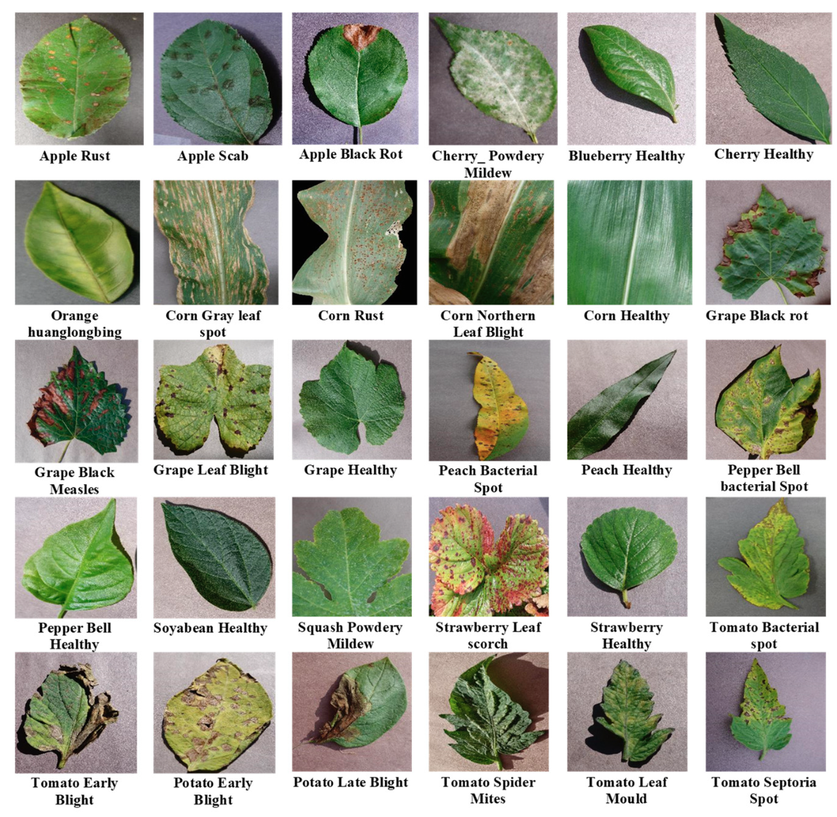

Datasets
Plant Village Dataset
It's a dataset for visual plant disease detection.
The dataset contains 54,306 images of 14 crop species with 26 diseases (or healthy)
Example - Apple Scab, Apple Black Rot, Tomato Bacterial Spot, Tomato Early Blight, Tomato Late Blight etc.
Fig 2. Leaf diseases from Plant Village dataset

Slide 6
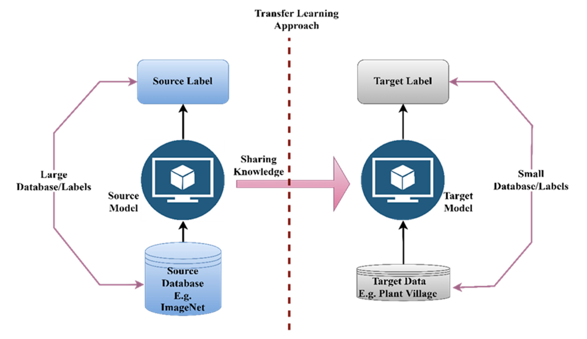

Training Mechanism
Transfer learning will be employed to leverage pre-trained models, typically trained on large-scale image datasets, to accurately classify Plant Diseases from images.
This approach proves particularly useful when dealing with limited labeled data for the specific plant disease identification task.
Figure 3. Basic idea behind transfer learning.

Slide 7
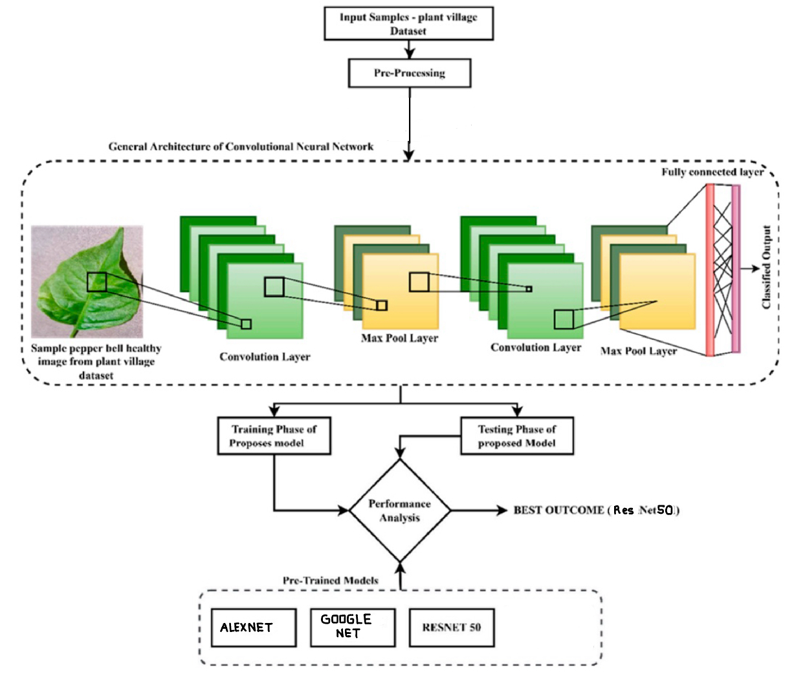
WORK FLOW
Figure 4. Project Work flow.

Slide 8
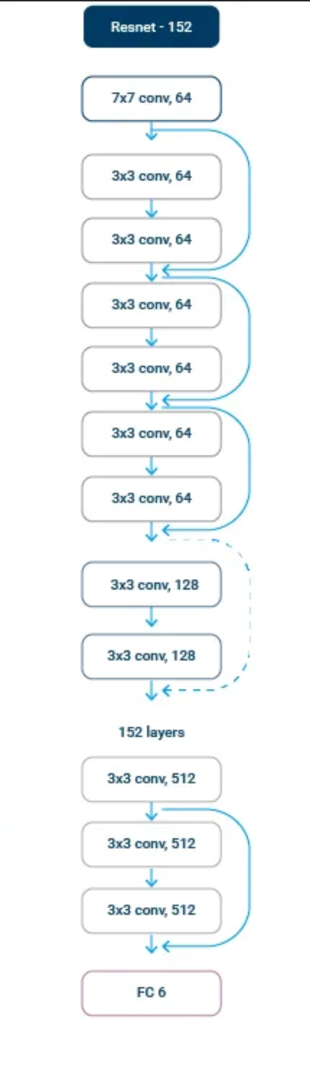

Resnet
Building Blocks:
Residual Block: Employs residual blocks with skip connections,facilitating the flow of gradients during training and addressing the challenge of vanishing gradients
BottleNeck Block: In the deeper layers of ResNet-50, a key innovation lies in its utilization of bottleneck blocks. These blocks incorporate a sequence of three convolutions: a 1x1 convolution (expansion), a 3x3 convolution (feature extraction), and another 1x1 convolution (compression). This strategic combination serves multiple purposes, primarily aiming to reduce computational complexity
Figure 5. Reset Architecture.

Slide 9
Modification:
We combined pre-trained ResNet50 base model with additional layers for fine-tuning. Batch normalization, dense layers with regularization, and dropout are included to improve the model's generalization.
The model is compiled for training with the specified Optimizer(Adamax), loss function(Categorical_crossentropy), and evaluation metric(f1 score, Accuracy).

Slide 10
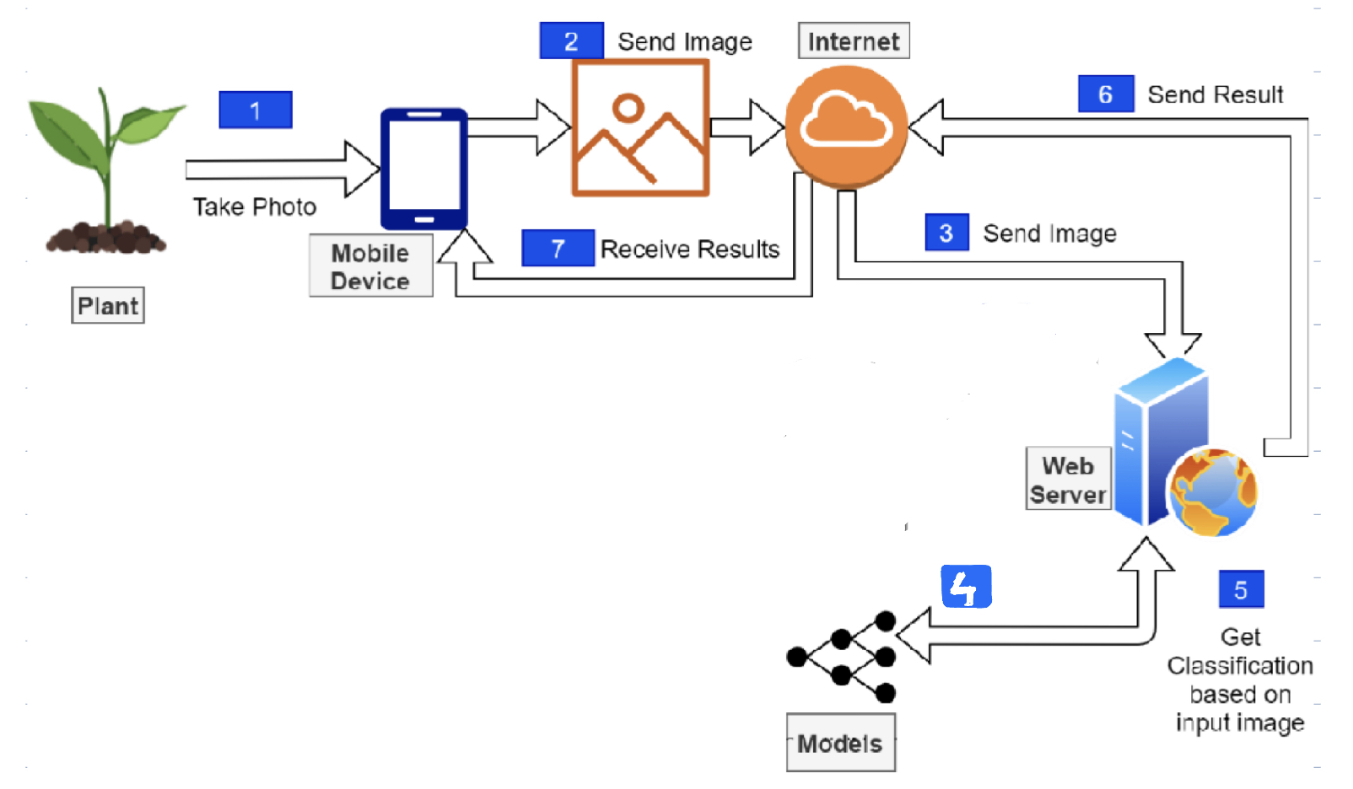
LEAF RAKSHAK
Figure 6. Leaf Rakshak WorkFlow.

Slide 11
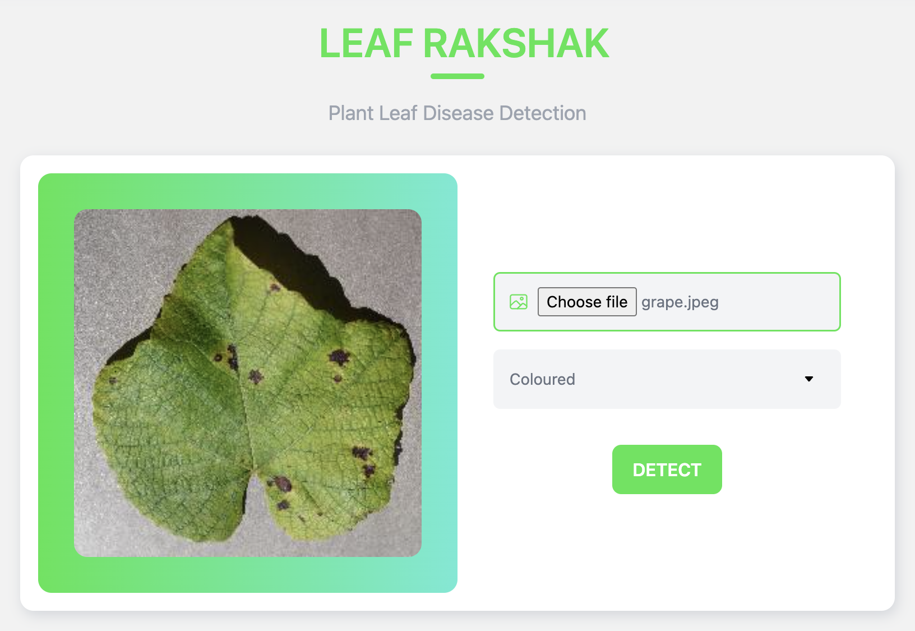
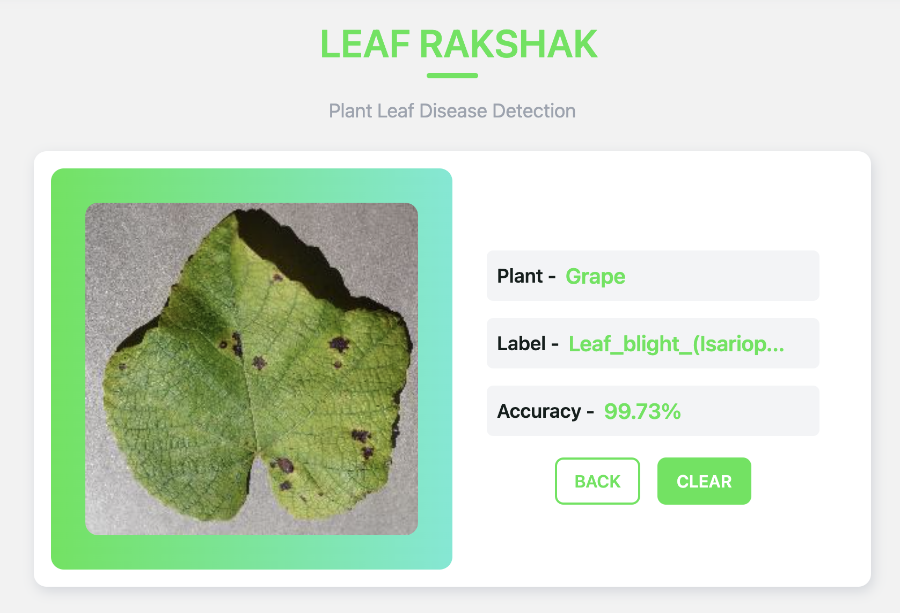
LEAF RAKSHAK
Figure 7. Coloured Image Input.
Figure 8. Coloured Image prediction.

Slide 12
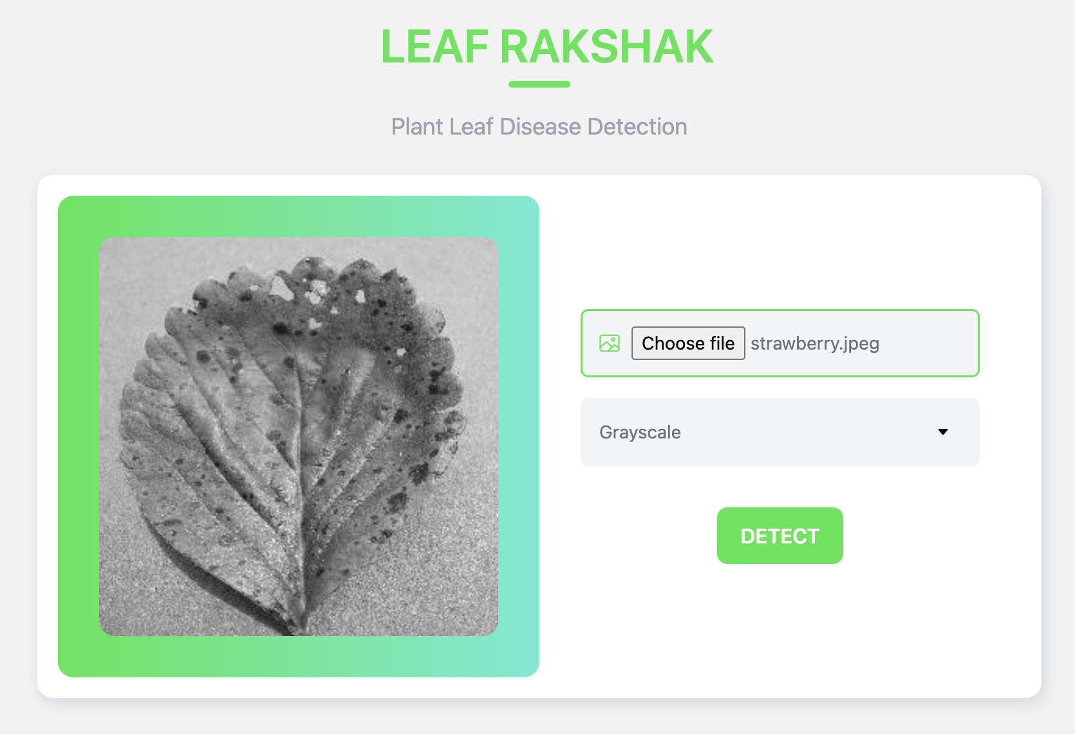
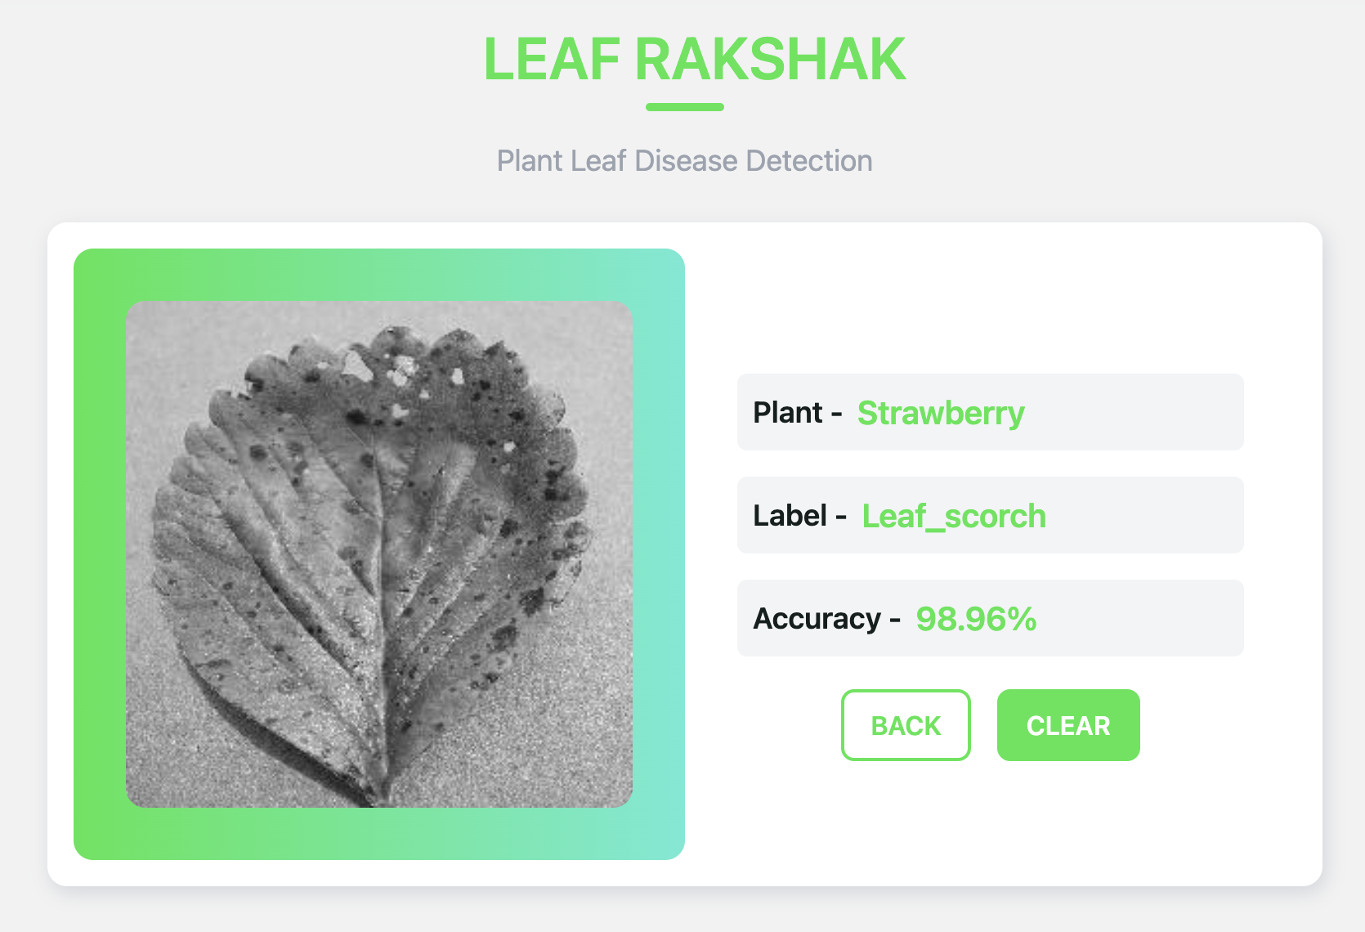
LEAF RAKSHAK
Figure 9. Grayscale Image Input.
Figure 10. Greyscale Image prediction.

Slide 13
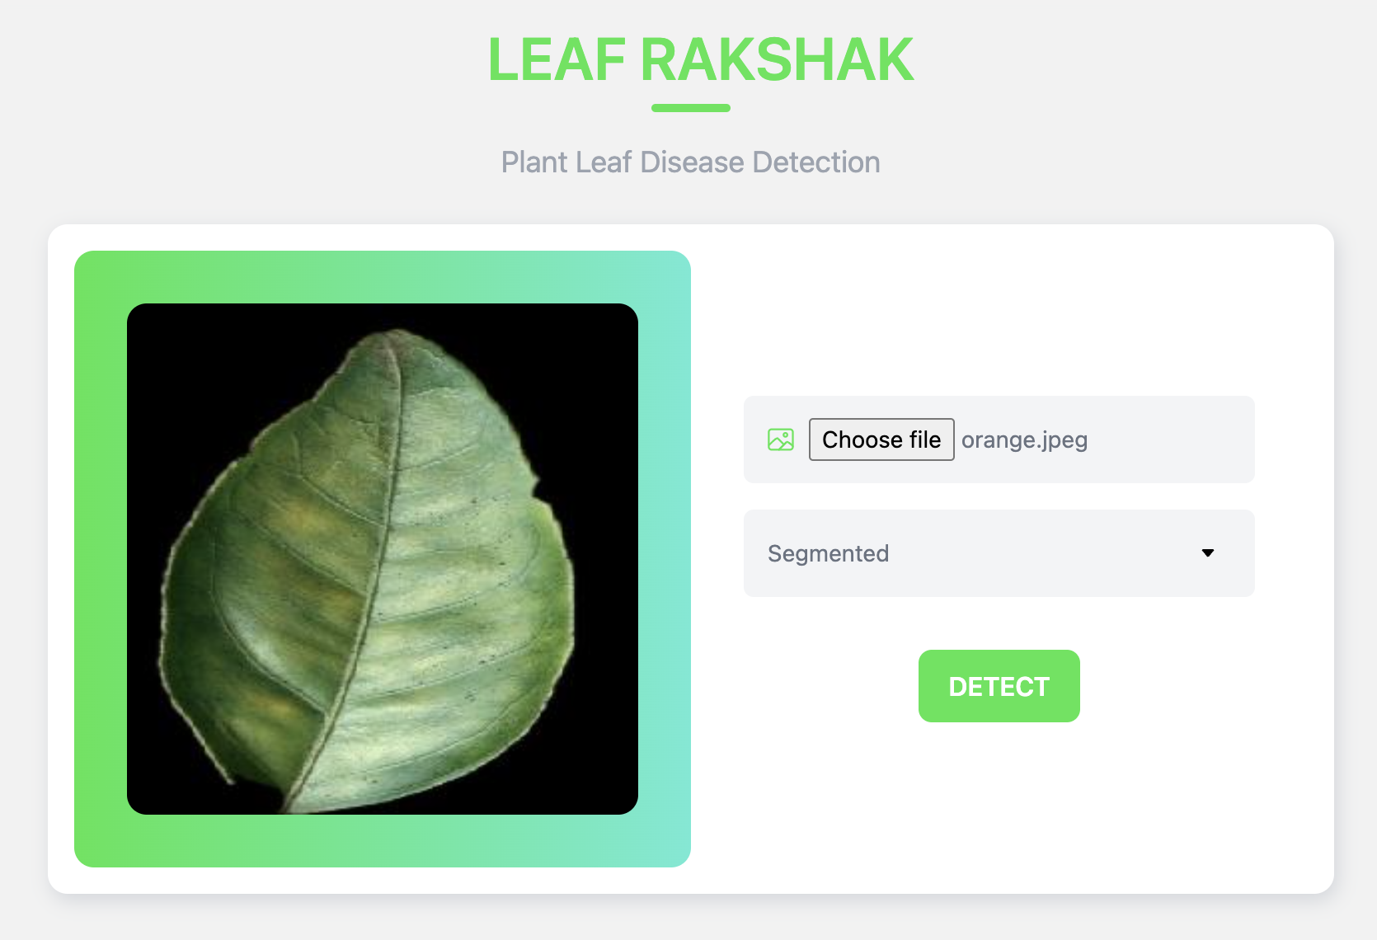
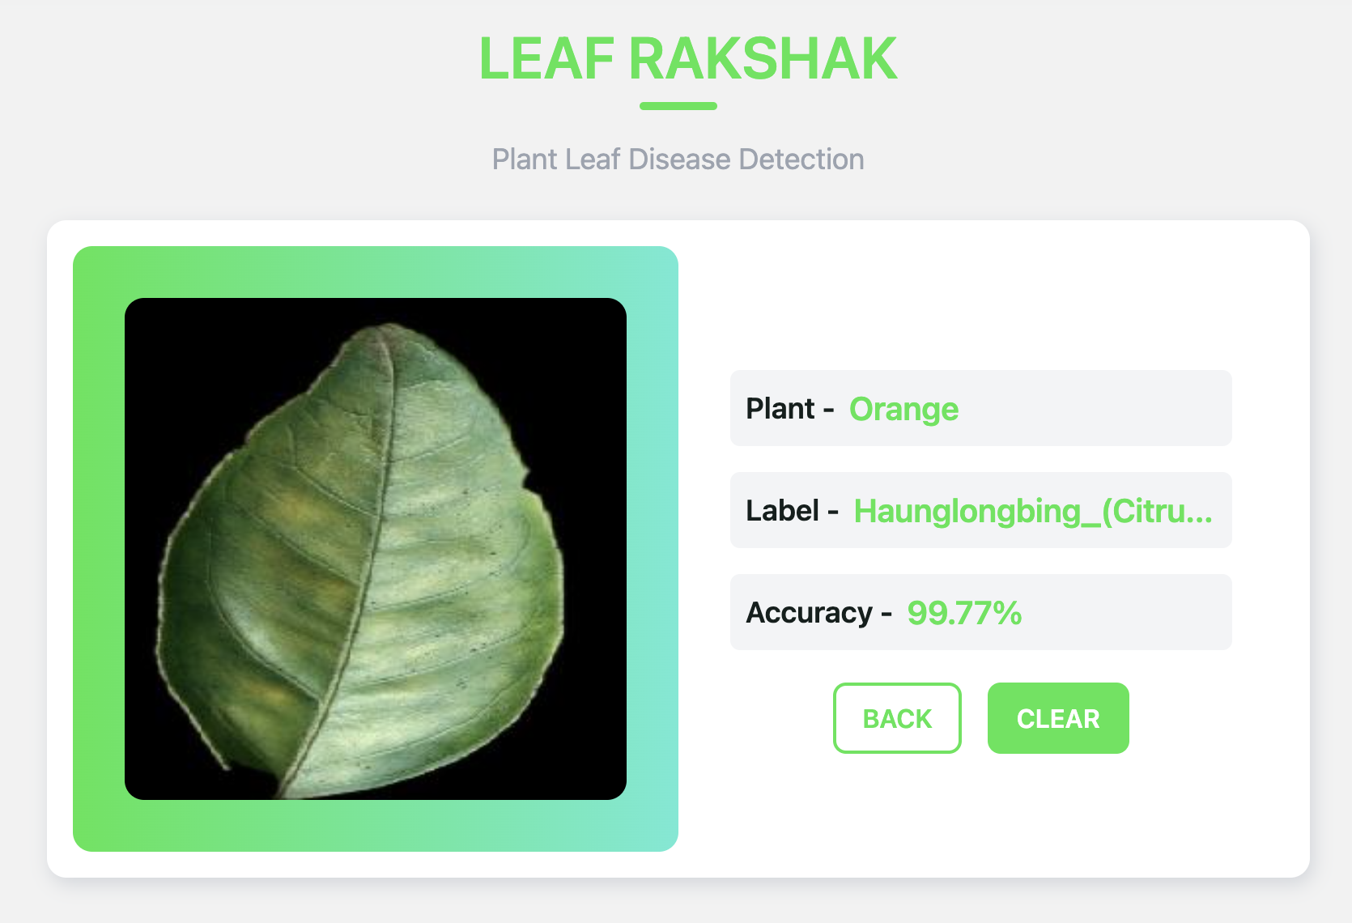
LEAF RAKSHAK
Figure 11. Segmented Image Input.
Figure 12. Segmented Image prediction.

Slide 14
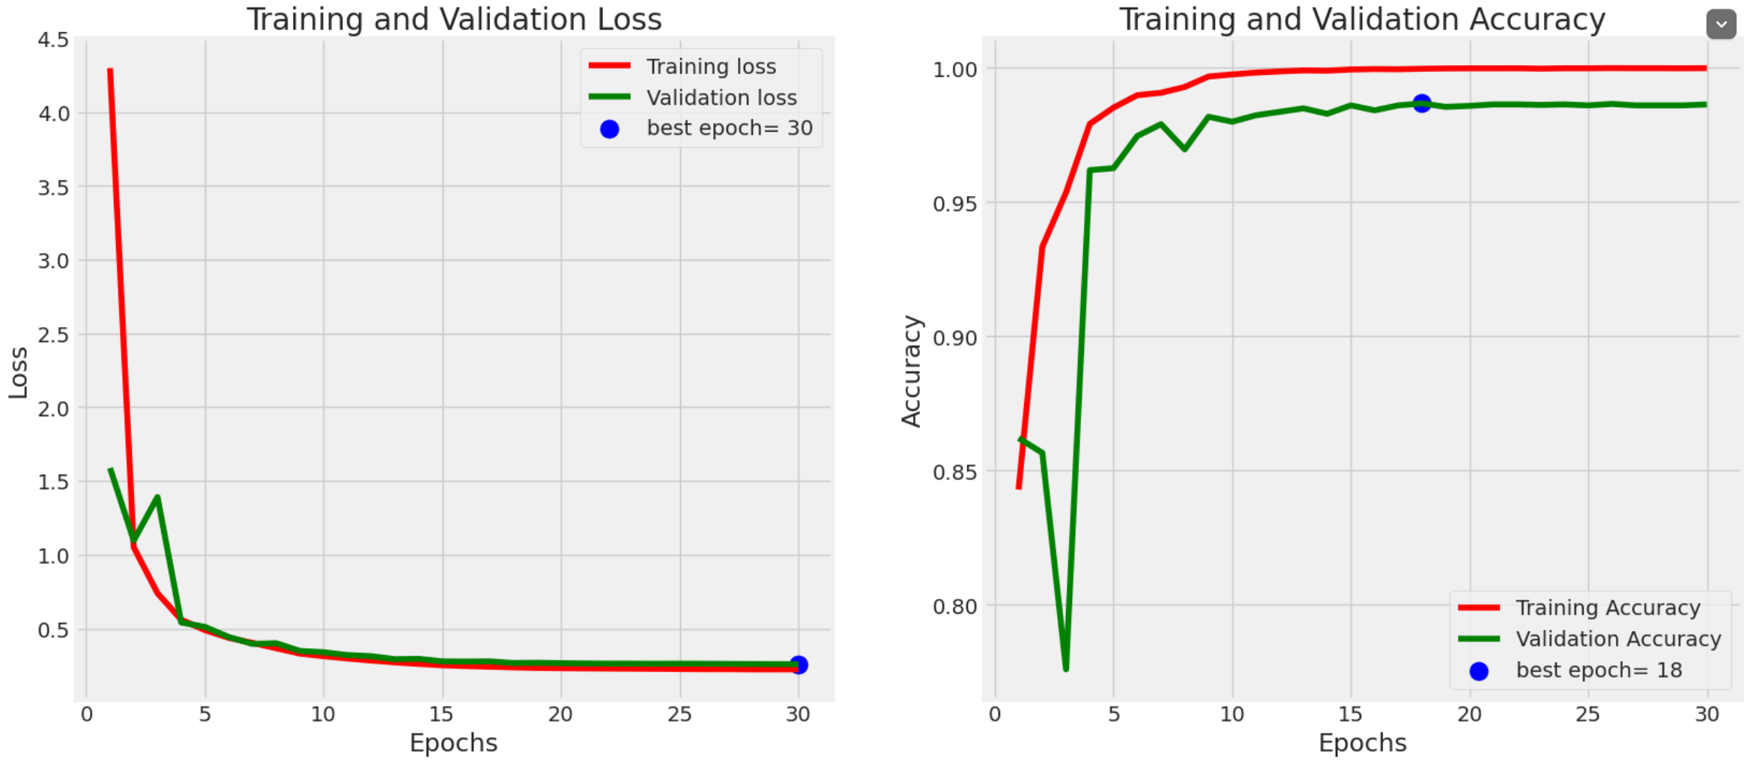
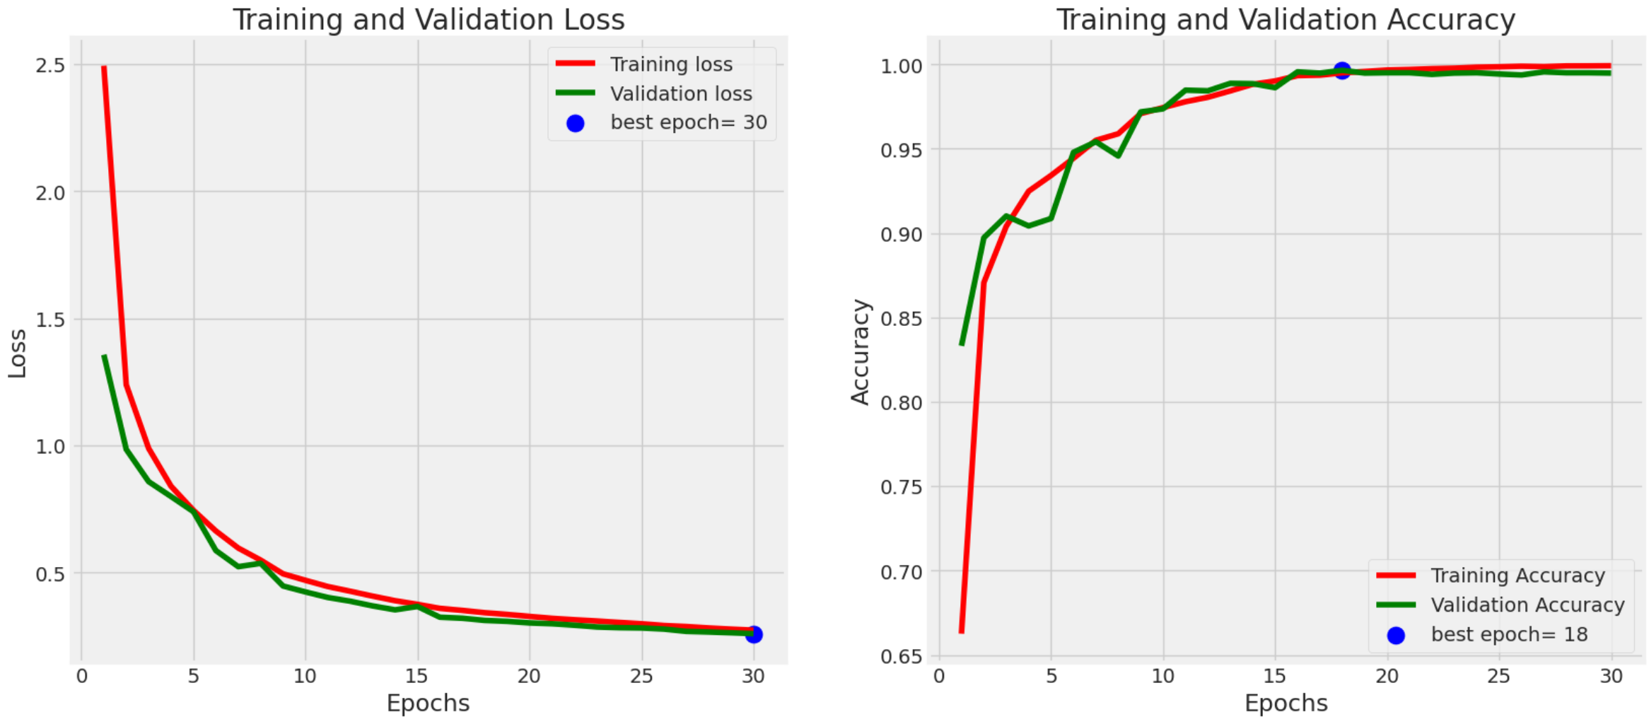
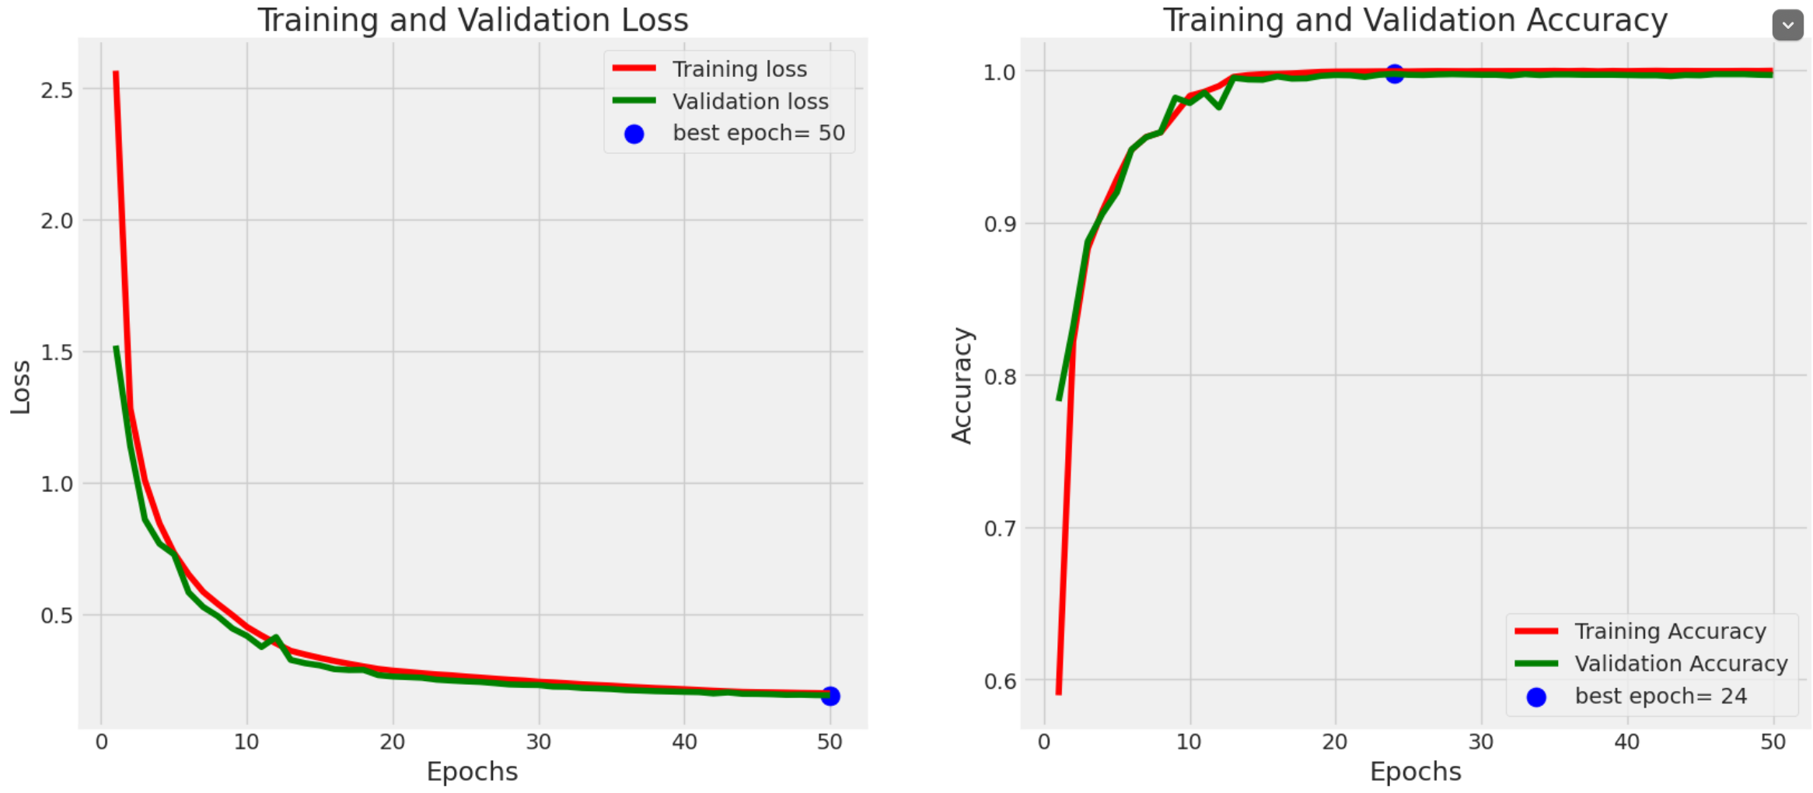
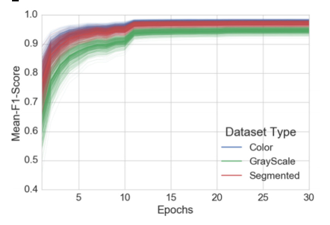
Experimental Results
Figure 13. Coloured (80,20 )Train Test Split.
Figure 14. Segmented (80,20 )Train Test Split.
Figure 15. Grayscale (80,20 )Train Test Split.
Figure 16. For (80,20 )Train Test Split.

Slide 15
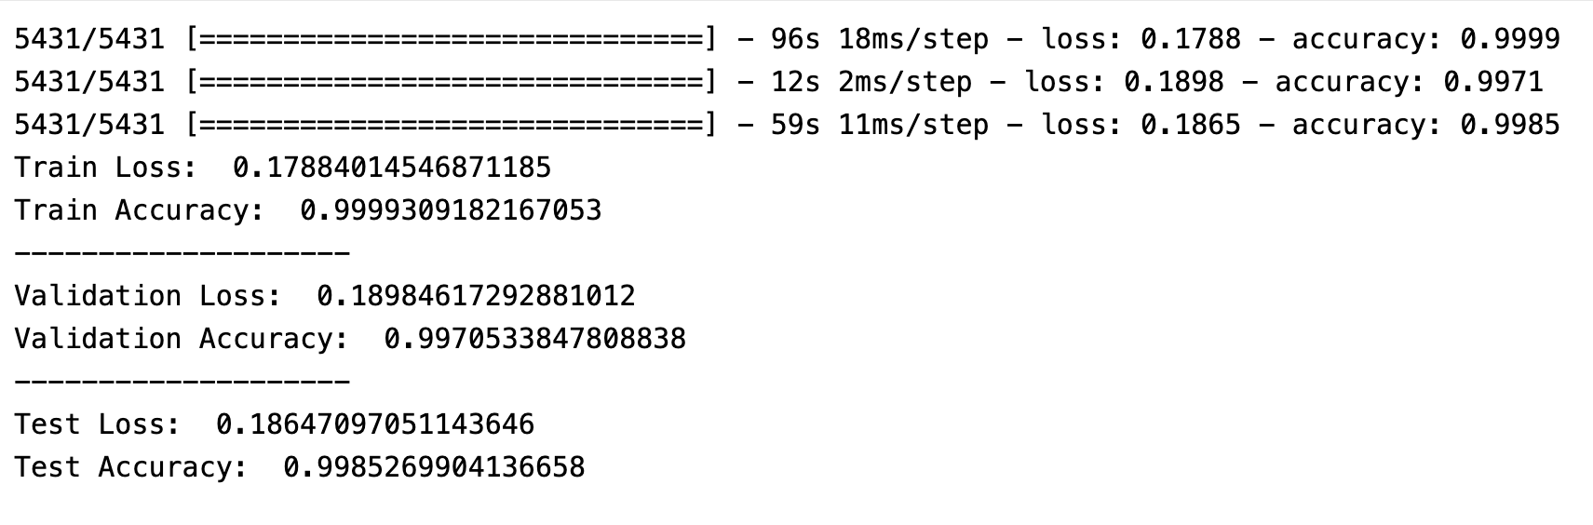
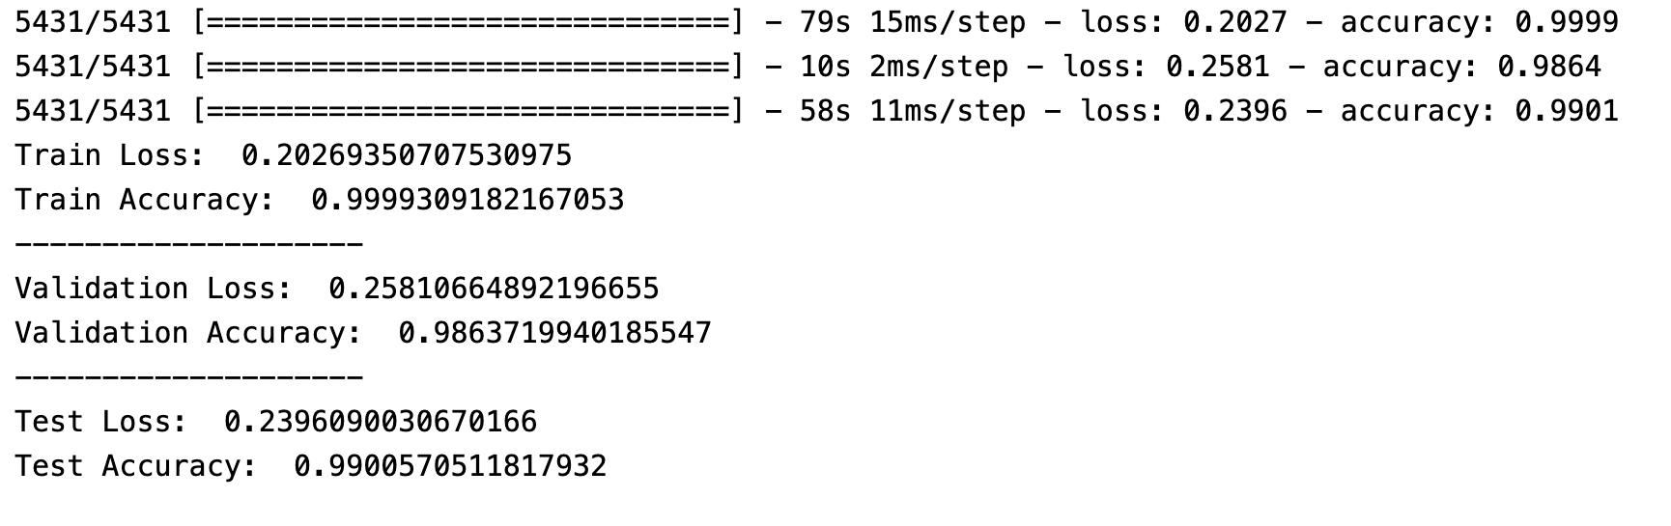
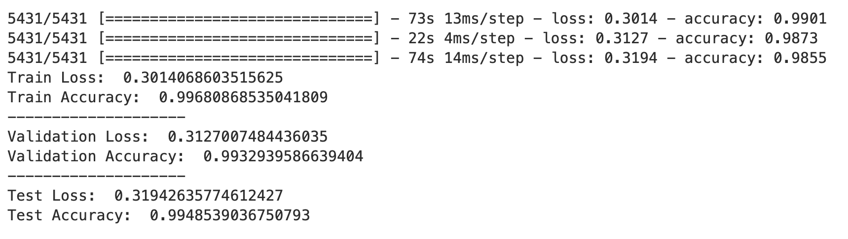
Experimental Results
Figure 17. Coloured (80,20 )Train Test Split.
Figure 18. GrayScale (80,20 )Train Test Split.
Figure 18. Grayscale 80_20.
Figure 19. Segmented 80_20.
Figure 19. Segmented (80,20 )Train Test Split.

Slide 16

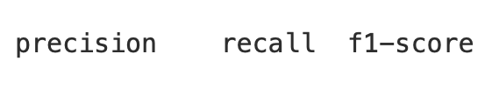
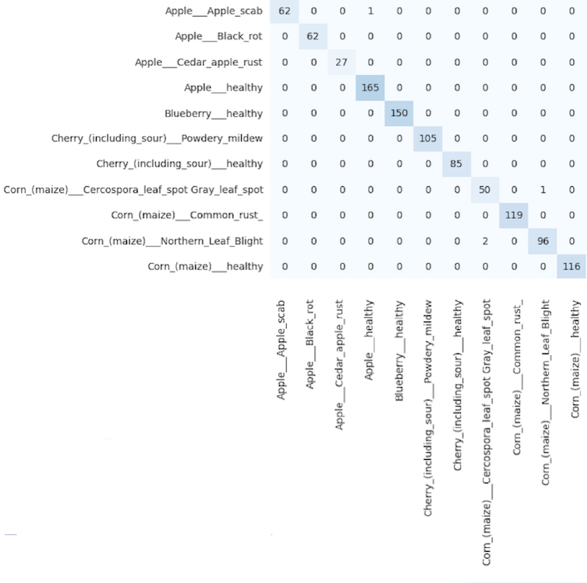
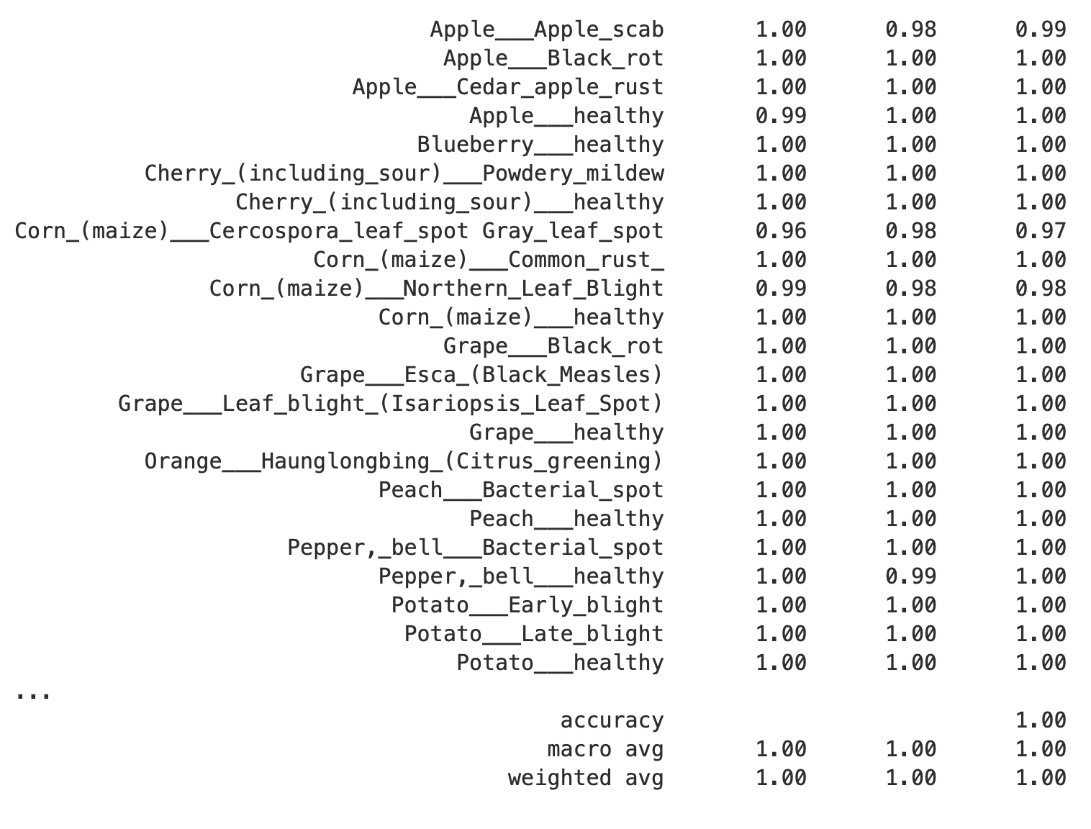
Experimental Results
Figure 20. F1 Scores for (80,20 )Train Test Split.
Figure 21. Confusion Matrix for (80,20)Train Test Split.

Slide 17
Comparative Results
 | AlexNet | GoogleNet | ResNet
Colour | 0.992 { 0.9928} | 0.9934 {0.9935} | 0.9968 {0.9985}
Grayscale | 0.9726 {0.9725} | 0.9800 {0.9798} | 0.9880 {0.9901}
Segmented | 0.9891 {0.9892} | 0.9925 {0.9924} | 0.9937 {0.9948}
Table 2. Result Comparison for (80,20) Train Test Split , Format MeanF1-Score{TestAccuracy}.

Slide 18
Comparative Results
 | AlexNet | GoogleNet | ResNet
Colour | 0.9907 {0.9907} | 0.9924 {0.9924} | 0.9943 {0.9970}
Grayscale | 0.9686 {0.9688} | 0.9785 {0.9787} | 0.9780 {0.9833}
Segmented | 0.9855 {0.9856} | 0.9905 {0.9906} | 0.9430 {0.9855}
Table 3. Result Comparison for (60,40) Train Test Split, Format MeanF1-Score{TestAccuracy}.

Slide 19

Application
Early Disease Detection:
Identifying plant diseases at an early stage is crucial for effective disease management.
Crop Monitoring:
Farmers can use the website for regular monitoring of their crops, enabling them to track the health status of their plants throughout the growing season
Extensions To Leaf Rakshak-
Decision Support System:
By integrating artificial intelligence and machine learning algorithms, the website can offer Personalized recommendations based on the specific conditions of a given crop and region.

Slide 20

References
[1] Prof. David P.Hughes et al. (2016). Using Deep Learning forImage-Based Plant Disease Detection
[2] Andrew J. et al.(2022). Deep Learning-Based Leaf Disease Detection in Crops Using Images for Agricultural Applications
[3] Davinder Singh et al.(2019). PlantDoc: A Dataset for Visual Plant Disease Detection
[4]Kranz, J. (1988). Measuring Plant Disease
[5] Zadoks, J. C. et al.(2002). Epidemiology and plant disease management.
[6] Richard N. Strang, Peter R. Scott (2005). Plant Disease: A Threat to Global Food Security

